Slide 1
Predicting Snowfall in Colorado Mountains
John Ortiz and Emily Parker

Slide 2
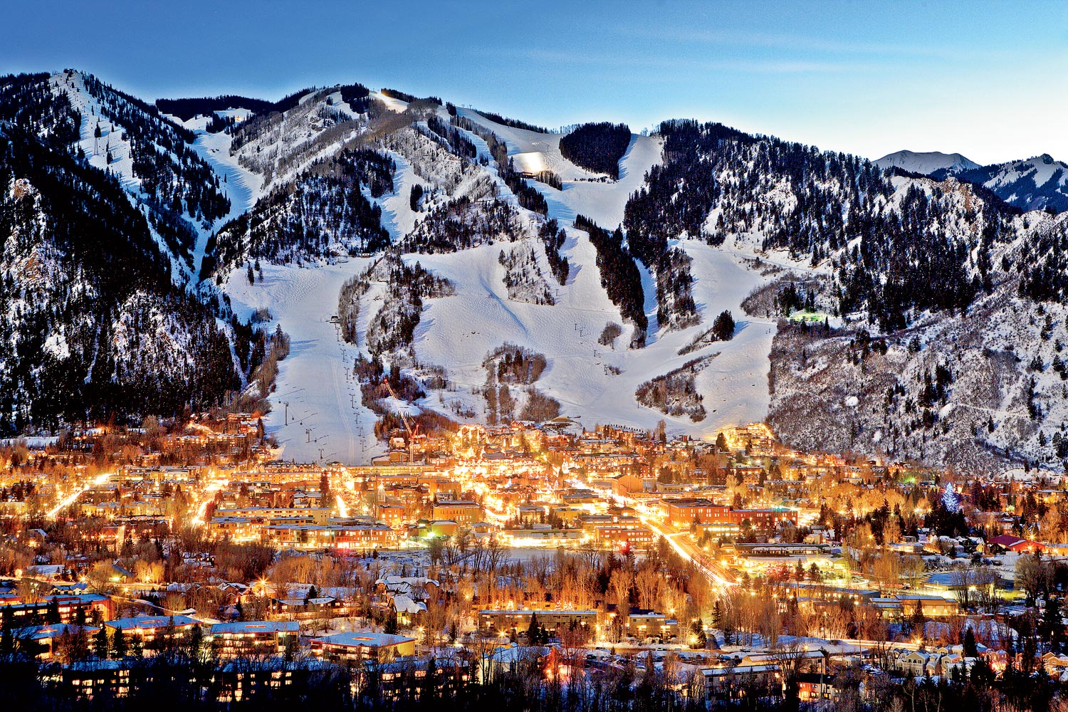
Problem Space
Weather in Colorado is unpredictable and can make timing a skiing trip difficult with unknown forecasts
Our goal is to use a Bayesian Neural Network to predict precipitation and snowfall at Colorado ski resorts
We hope to build a model that is able to use more certain forecasts, such as temperature, to predict the uncertain Colorado snowfall

Slide 3
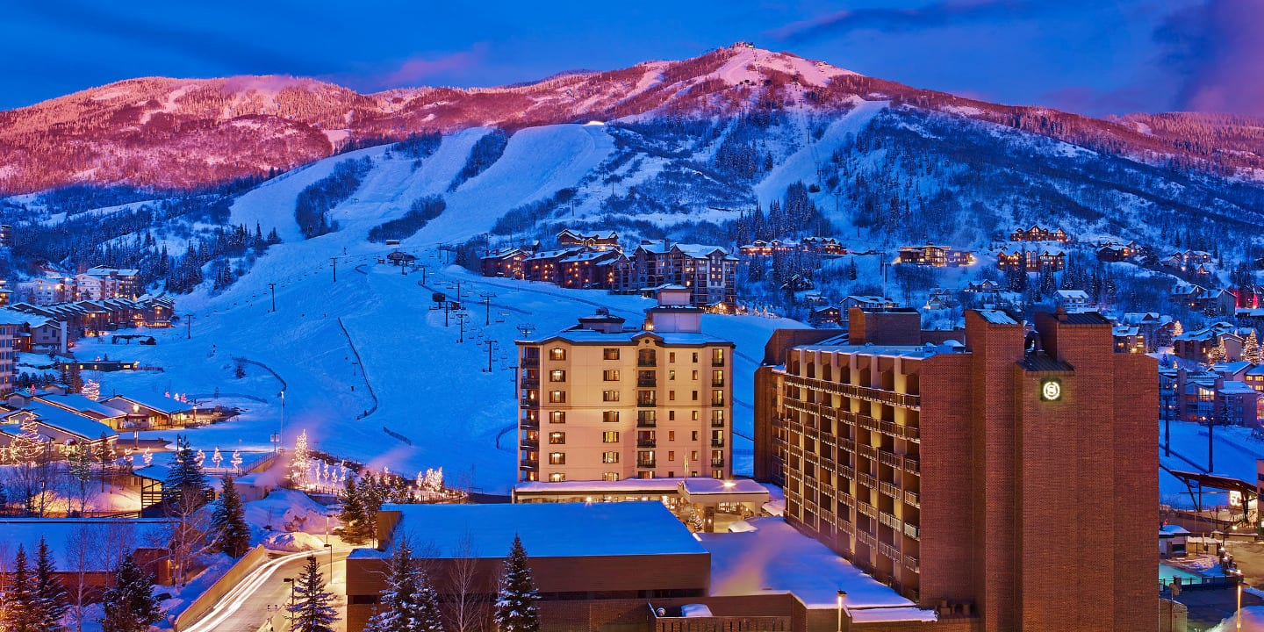
Data Acquisition
Acquired data from Colorado Weather API URL builder [1]
Mountains selected - (Daily from Jan 2018 through Dec 2022)
Aspen - 1751 Days
Steamboat - 1715 Days
Vail - 1738 Days
Columns: High Temperature, Low Temperature, Precipitation, Snowfall

Slide 4
Implementation
Mapped data with
Bayesian Belief Network
Bayesian Neural Network
Markov Model
Will used Kullback-Leibler Variational Inference method to approximate if snow will fall on day given certain condition
tensorflow_probability.layers.DenseFlipout() [2]

Slide 5
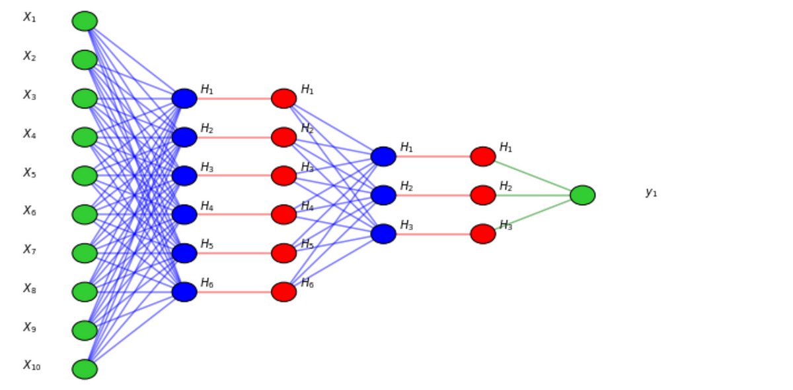
Bayesian Neural Network
Input Layer
Dense Layers
Dropout Layers
Dense Flipout
Output Layer
Snow Level Predictions
Dense Flipout is a “gradient estimator to minimize the Kullback-Leibler divergence up to a constant” [2]
[3]

Slide 6
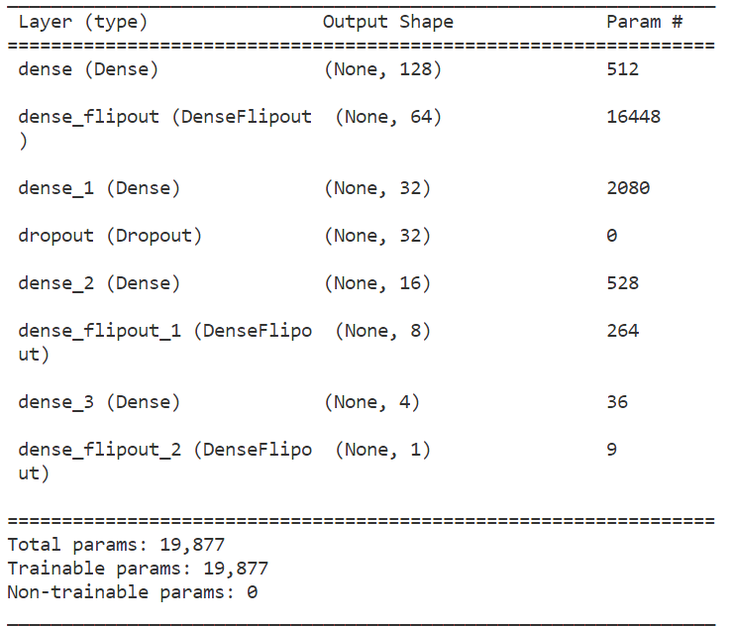
Model Summary

Slide 7
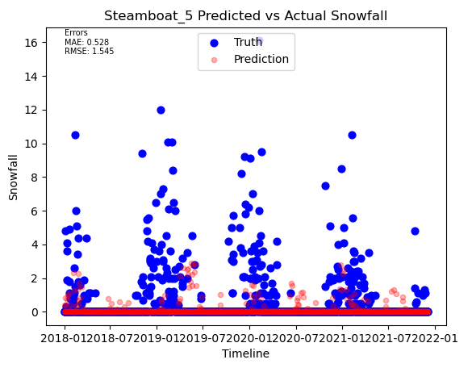
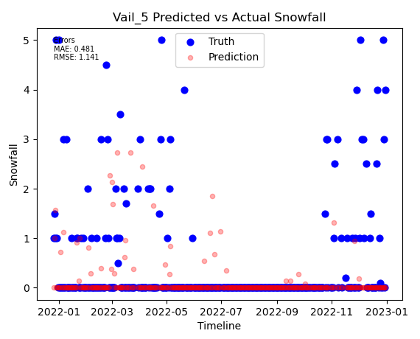
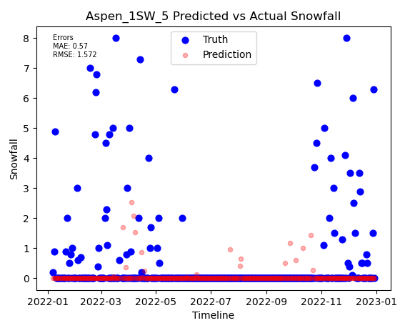
Current Results

Slide 8
Conclusion
We found some reasonable accuracy to predict snowfall in some resorts in the Colorado Mountains
The intertwined dependencies of weather forecasts cause complications in ascertaining independence statements when looking for other methods
The use of a Bayesian Neural Network allowed for variational inference to be included across states, and for a KL based divergence

Slide 9
Next Steps
Finalize networks to improve performance
Look into Normalization to better balance the data
Finish parameter inference on precipitation and snowfall levels
Look at ways which the models could be improved, but which we don’t have time to implement
Finish writing the report

Slide 10
Questions?
Notes:
replace mountain pic

Slide 11
References
[1] Scott, W. (2023). Access Colorado Data. Colorado Climate Center - Data Access. https://climate.colostate.edu/data_access_new.html
[2] Tfp.layers.denseflipout : tensorflow probability. TensorFlow. (2023, February 23). https://www.tensorflow.org/probability/api_docs/python/tfp/layers/DenseFlipout
[3] Pietro, M. D. (2022, April 16). Deep learning with python: Neural networks (complete tutorial). Medium. https://towardsdatascience.com/deep-learning-with-python-neural-networks-complete-tutorial-6b53c0b06af0

